Slide 1
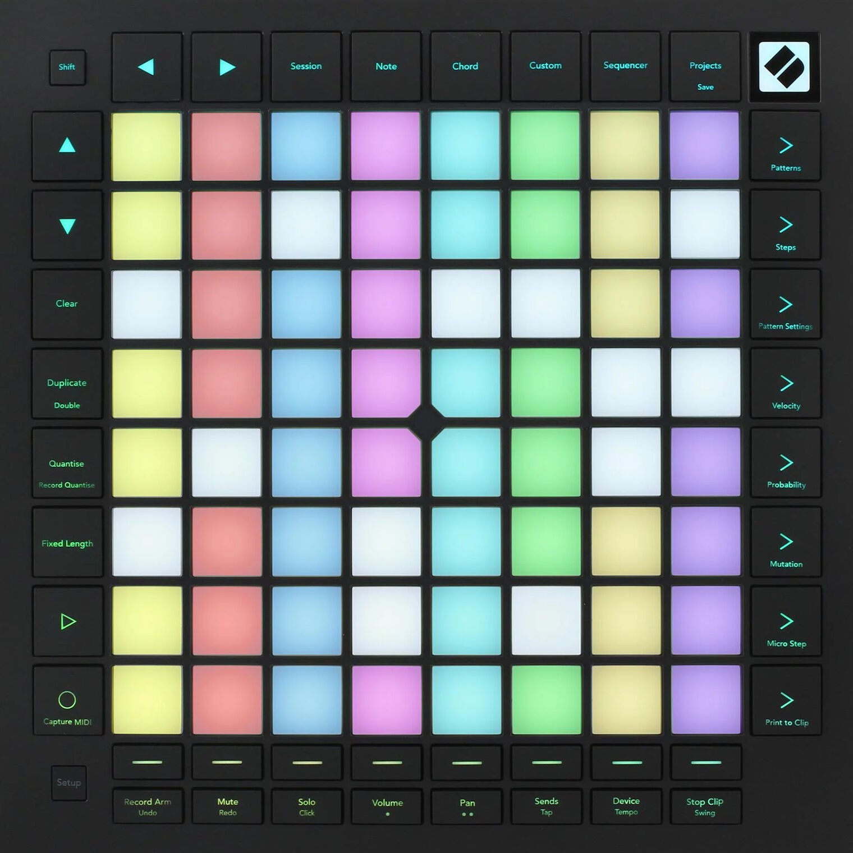
Ninja Pulse
Your objective is to remember a sequence of shurikens, and input it on the Ninja Pulse in the same order.

Slide 2
Ninja Pulse
Your objective is to remember a sequence of shurikens, and input it on the Ninja Pulse in the same order.

Slide 3
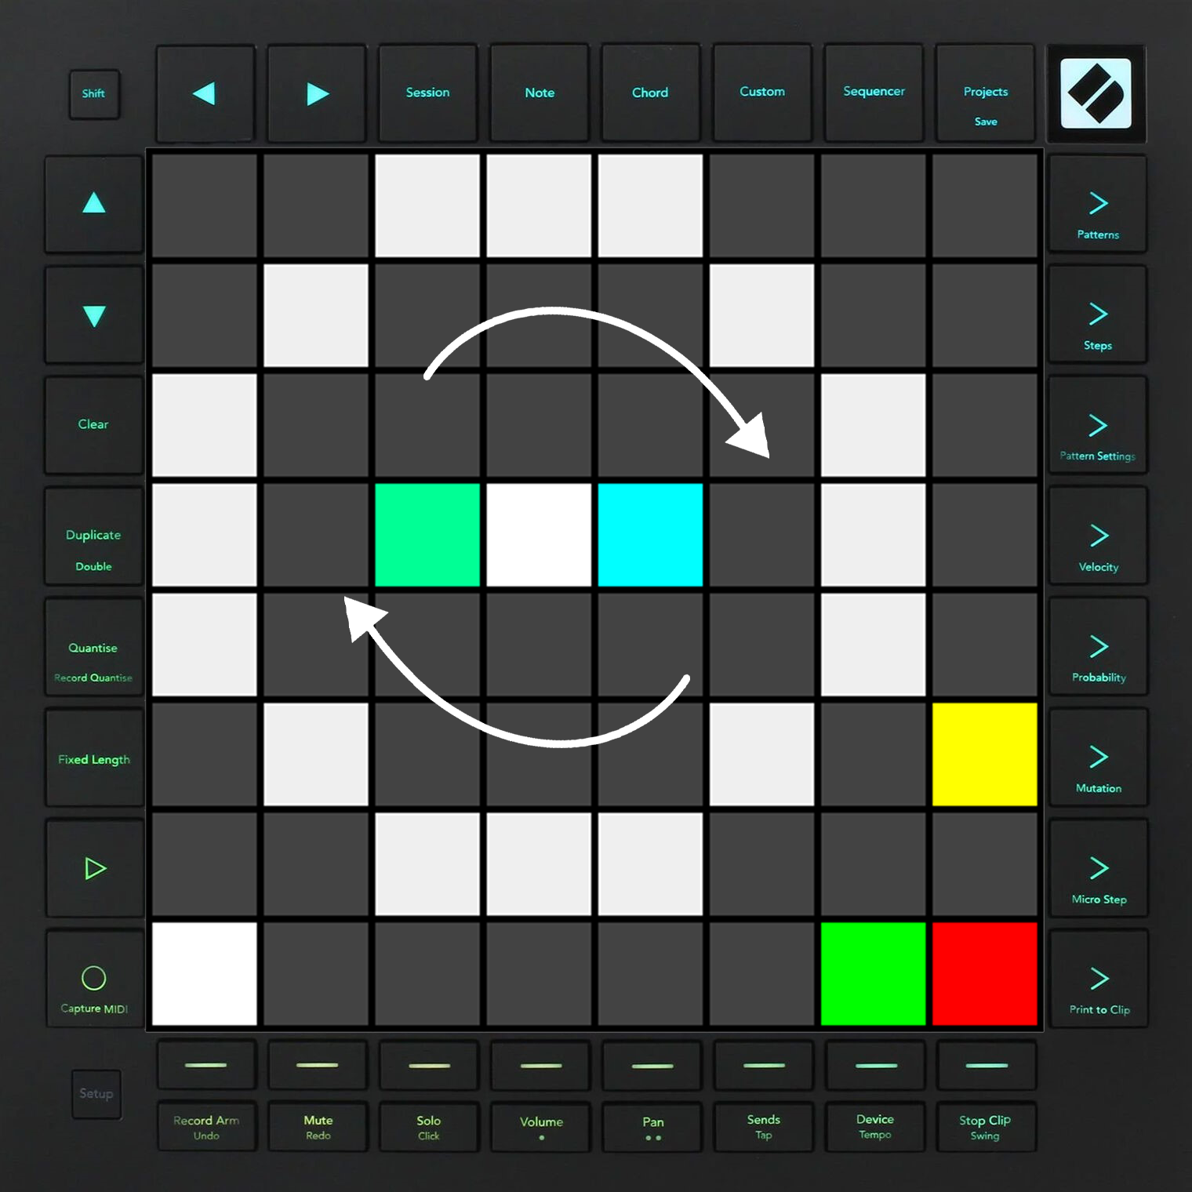
Ninja Pulse
Your objective is to remember a sequence of shurikens, and input it on the Ninja Pulse in the same order.
Easy Mode

Slide 4
Your objective is to remember a sequence of shurikens, and input it on the Ninja Pulse in the same order.
Easy Mode

Slide 5
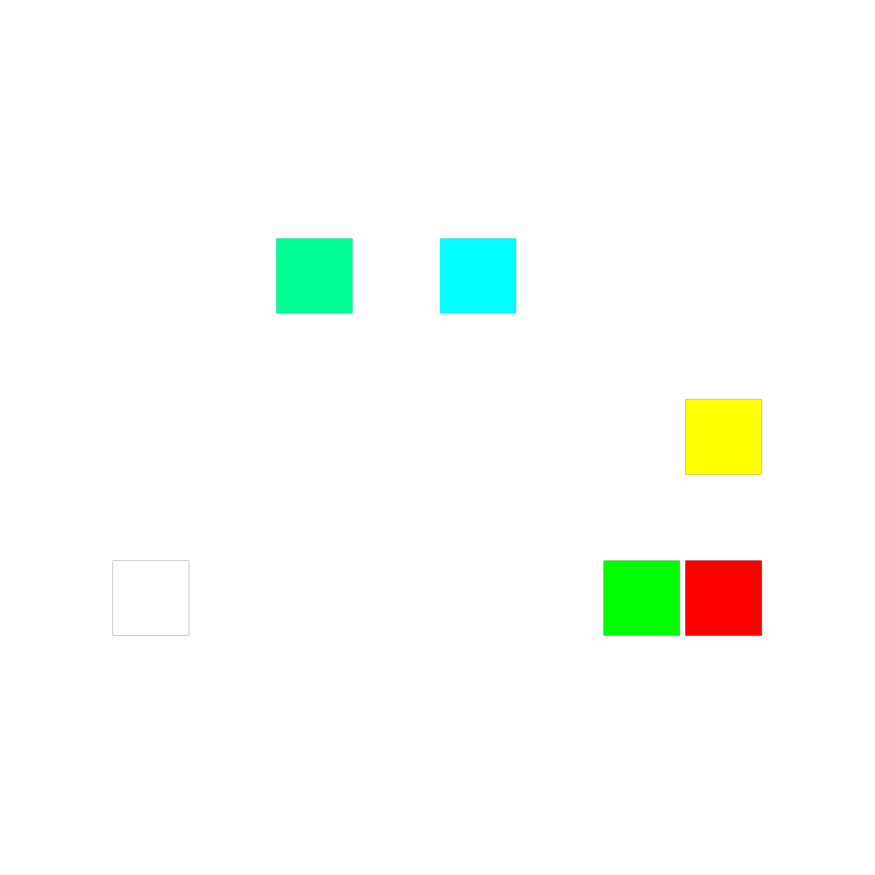
Easy Mode
Right Button
Left Button
Submit Button
Easy Mode
Level starts
Hard Mode

Slide 6

If you fail to input correctly, you will be punished via smoking.

Slide 7
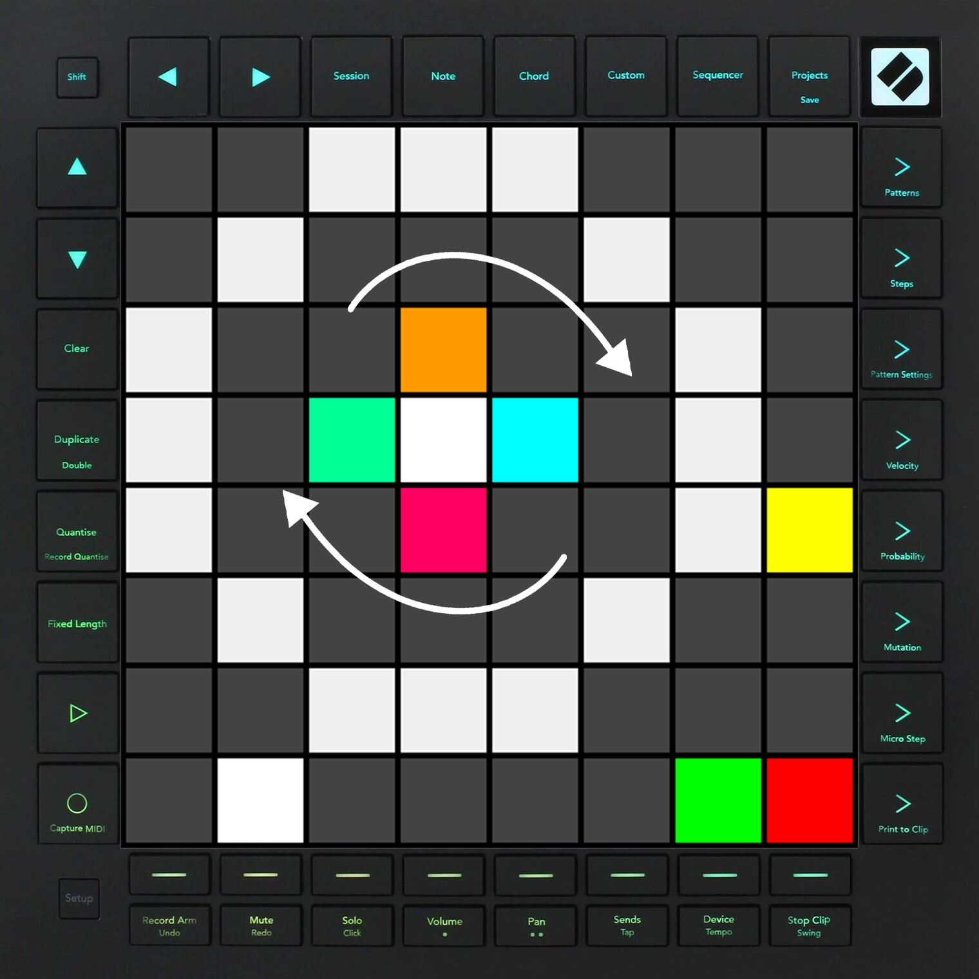
Hard Mode

Slide 8

Hard Mode
Front Button
Right Button
Left Button
Back Button
Submit Button
Easy Mode
Level starts
Hard Mode

